Slide 1
SDLC

Slide 2
SDLC – Software Development Life Cycle
Software Development Life Cycle (SDLC) is a framework that defines the steps involved in the development of software at each phase.
The Phases of the SDLC
Requirements Gathering & Analysis
Design
Coding
Testing
Deployment
Maintenance

Slide 3
Requirements Gathering & Analysis
During this phase, all the relevant information is collected from the customer to develop a product as per their expectation. Any ambiguities must be resolved in this phase only.
Business analyst and Project Manager set up a meeting with the customer to gather all the information like what the customer wants to build, who will be the end-user, what is the purpose of the product. Before building a product a core understanding or knowledge of the product is very important.
For Example, A customer wants to have an application which involves money transactions. In this case, the requirement has to be clear like what kind of transactions will be done, how it will be done, in which currency it will be done, etc.
Once the requirement gathering is done, an analysis is done to check the feasibility of the development of a product. In case of any ambiguity, a call is set up for further discussion.
Once the requirement is clearly understood, the SRS (Software Requirement Specification) document is created. This document should be thoroughly understood by the developers and also should be reviewed by the customer for future reference.

Slide 4
Feasibility Study
The some of the feasibility checks done are:
Economic: Can we complete the project within the budget or not?
Operation feasibility: Can we create operations(functionality) which is expected by the client?
Technical: Need to check whether the current computer system can support the software
Schedule: Decide that the project can be completed within the given schedule or not.
Legal: Can we handle this project as cyber law and other regulatory framework/compliances.

Slide 5
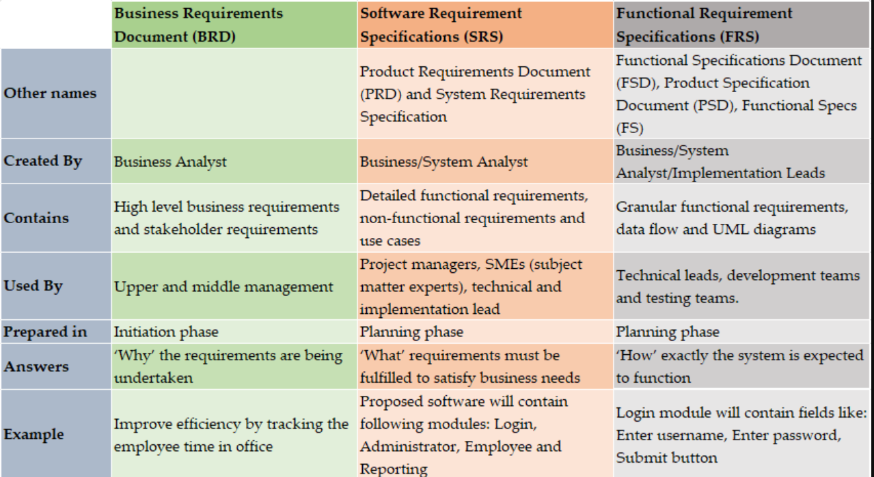
BRD vs SRS vs FRS

Slide 6
Stakeholders in a Project
Some of the typical key project stakeholders you'll find in a project include:
Customers: The direct user of a product or service, often both internal and external to the company executing the project
Project manager: The project's leader
Project team members: The group executing the project under the project manager's leadership
Project sponsor: The project's financier
Steering committee: An advisory group providing guidance on key decisions, which includes the sponsor, executives, and key stakeholders from the organization
Executives: The top management in the company executing the project; those who direct the organization's strategy
Resource managers: Other managers who control resources needed for executing the project

Slide 7
Design
In this phase, the system and software design documents are prepared as per the requirement specification document. This helps define overall system architecture. This design phase serves as input for the next phase of the model.
There are two kinds of design documents developed in this phase:
High-Level Design (HLD)
Brief description and name of each module
An outline about the functionality of every module
Interface relationship and dependencies between modules
Database tables identified along with their key elements
Complete architecture diagrams along with technology details
Low-Level Design(LLD)
Functional logic of the modules
Database tables, which include type and size
Complete detail of the interface
Addresses all types of dependency issues
Listing of error messages
Complete input and outputs for every module

Slide 8
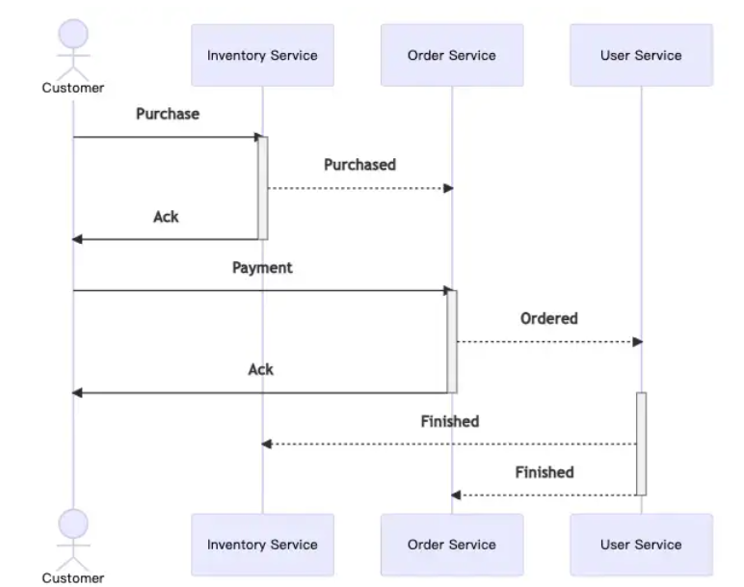
High Level Design of Ecommerce Application

Slide 9
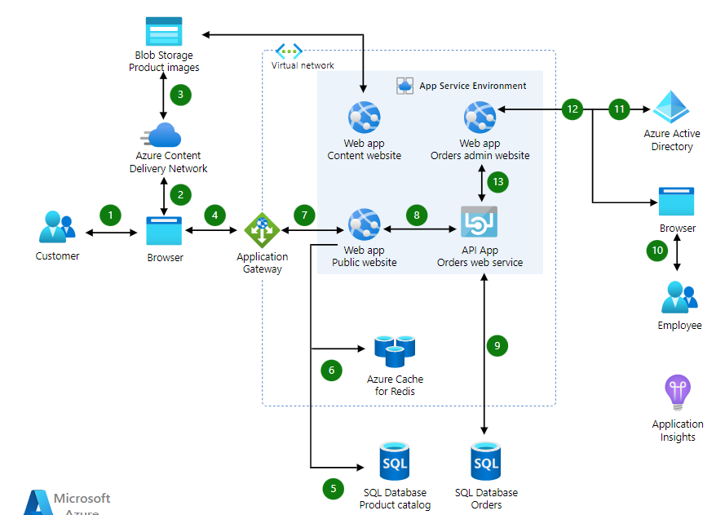
Another Example

Slide 10
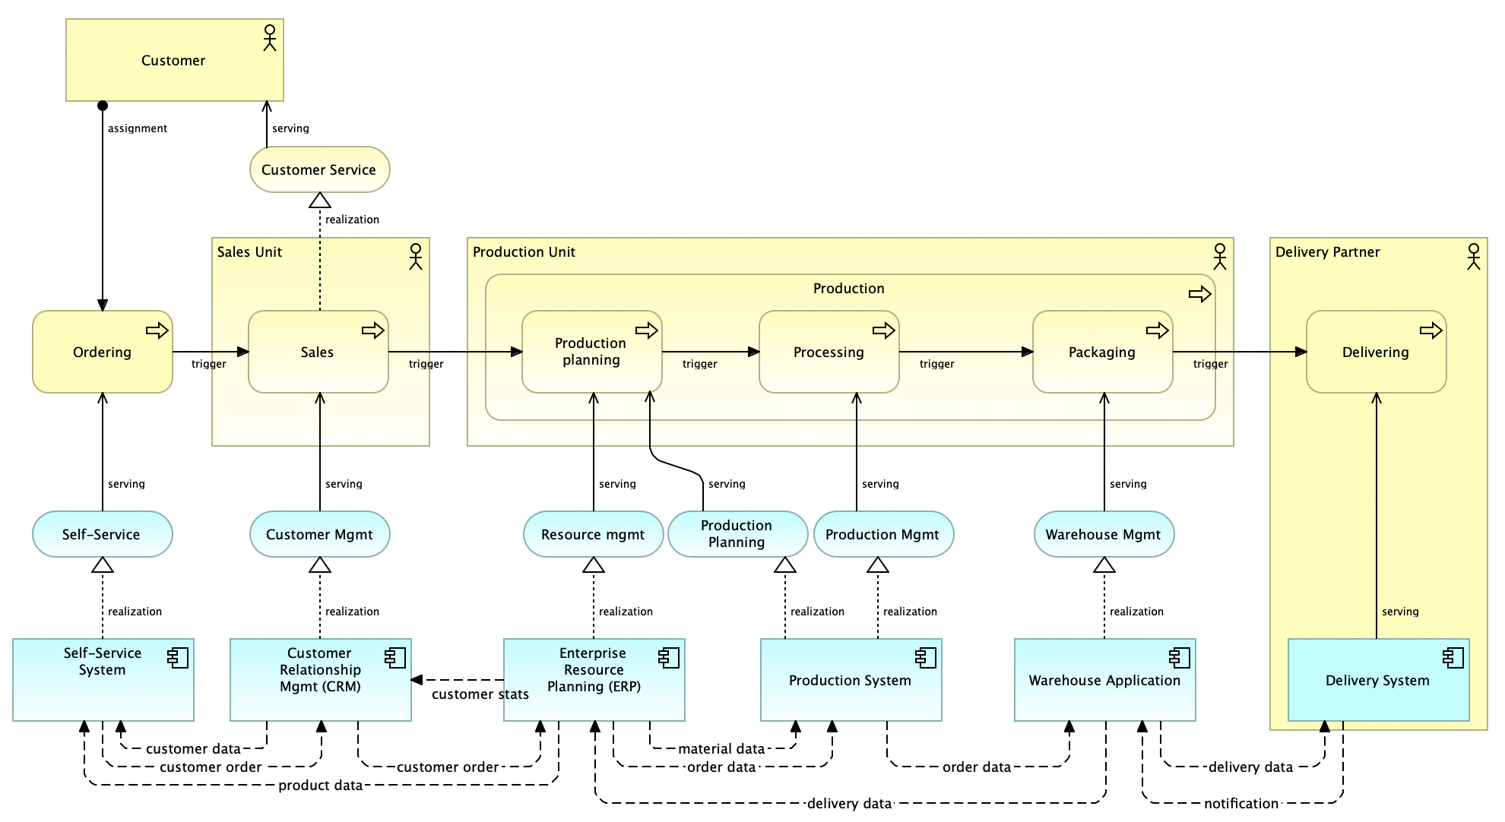
Sample Low Level Design Doc

Slide 11
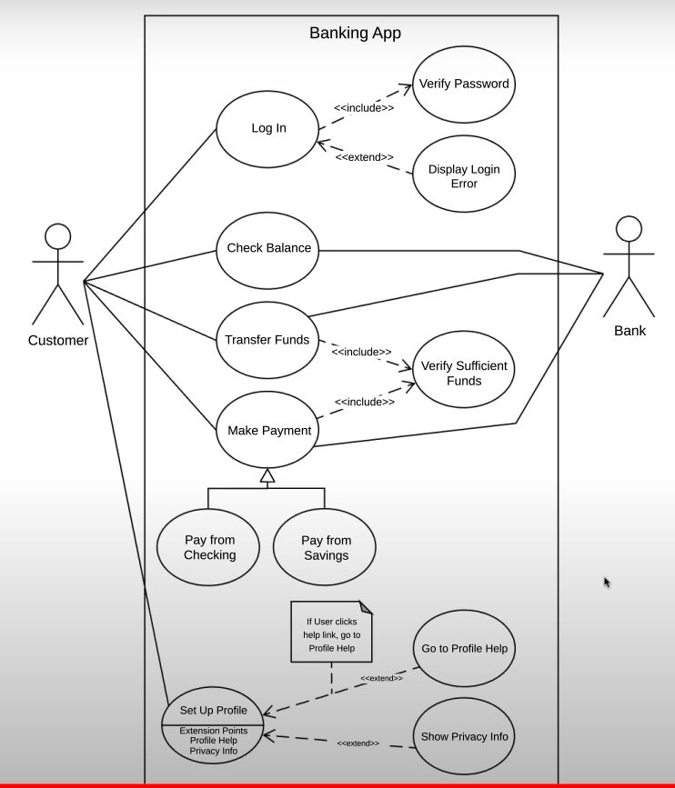
Use Case Diagram (UML)

Slide 12
Coding
Once the system design phase is over, the next phase is coding. In this phase, developers start build the entire system by writing code using the chosen programming language. In the coding phase, tasks are divided into units or modules and assigned to the various developers. It is the longest phase of the Software Development Life Cycle process.
In this phase, Developer needs to follow certain predefined coding guidelines. They also need to use programming tools like compiler, interpreters, debugger to generate and implement the code.
The code is developed and verified if it is working as per the requirement in the Development Environment.

Slide 13
Testing
Testing starts once the coding is complete and the modules are released for testing. In this phase, the developed software is tested thoroughly and any defects found are assigned to developers to get them fixed.
Retesting, regression testing is done until the point at which the software is as per the customer’s expectation. Testers refer SRS document to make sure that the software is as per the customer’s standard.

Slide 14
Deployment
Once the product is tested, it is deployed in the production environment or first UAT (User Acceptance testing) is done depending on the customer expectation.
In the case of UAT, a replica of the production environment is created and the customer along with the developers does the testing. If the customer finds the application as expected, then sign off is provided by the customer to go live.

Slide 15
Maintenance
Once the system is deployed, and customers start using the developed system, following 3 activities occur
Bug fixing - bugs are reported because of some scenarios which are not tested properly
Upgrade - Upgrading the application to the newer versions of the Software
Enhancement - Adding some new features into the existing software
The main focus of this SDLC phase is to ensure that needs continue to be met and that the system continues to perform as per the specification mentioned in the first phase.

Slide 16
Different SDLC Models

Slide 17
SDLC Models
Waterfall Model
V-Shape Model
Prototype Model
Iterative Model
Spiral Model
Rapid Application Development (RAD)
Agile Model

Slide 18
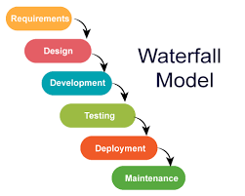
Waterfall Model

Slide 19
When Should You Use It ?
Requirements are clear and fixed that may not change.
There are no ambiguous requirements (no confusion).
It is good to use this model when the technology is well understood.
The project is small and cost is low.
Risk is zero or minimum.

Slide 20
Advantages
It is simple and easy to understand and use.
It is easy to manage.
It works well for smaller and low budget projects where requirements are very well understood.
Clearly defined stages and well understood.
It is easy to arrange tasks.
Process and results are well documented.

Slide 21
Disadvantages
Cannot accommodate changing requirements
No working software is produced until late during the life cycle.
It is difficult to measure progress within stages.
Poor model for long and ongoing projects.
High amounts of risk and uncertainty.
Not a good model for long and object oriented projects.

Slide 22
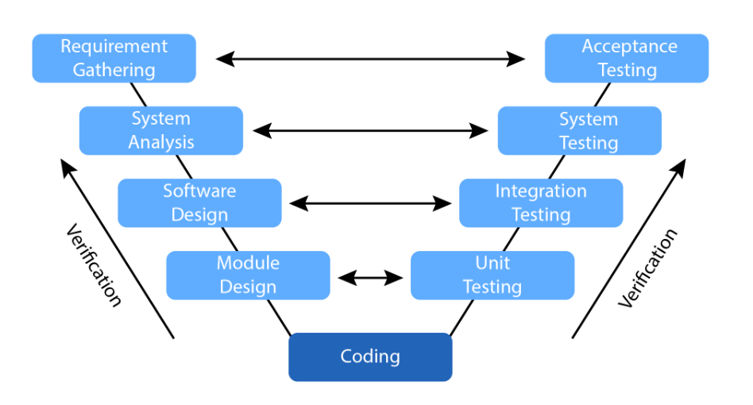
V Model
Validation

Slide 23
When to use V Model?
Excellent choice for systems requiring high reliability – hospital patient control applications
All requirements are known up-front
When it can be modified to handle changing requirements beyond analysis phase
Solution and technology are known

Slide 24
Advantages
Simple and easy to use.
Testing activities like planning, test designing happens well before coding. This saves a lot of time. Hence higher chance of success over the waterfall model.
Proactive defect tracking – that is defects are found at early stage.
Avoids the downward flow of the defects.
Works well for small projects where requirements are easily understood.

Slide 25
Disadvantages
The risk is high and unpredictable.
Software is developed during the implementation phase, so no early prototypes of the software are produced.
If any changes happen in midway, then the test documents along with requirement documents has to be updated.

Slide 26
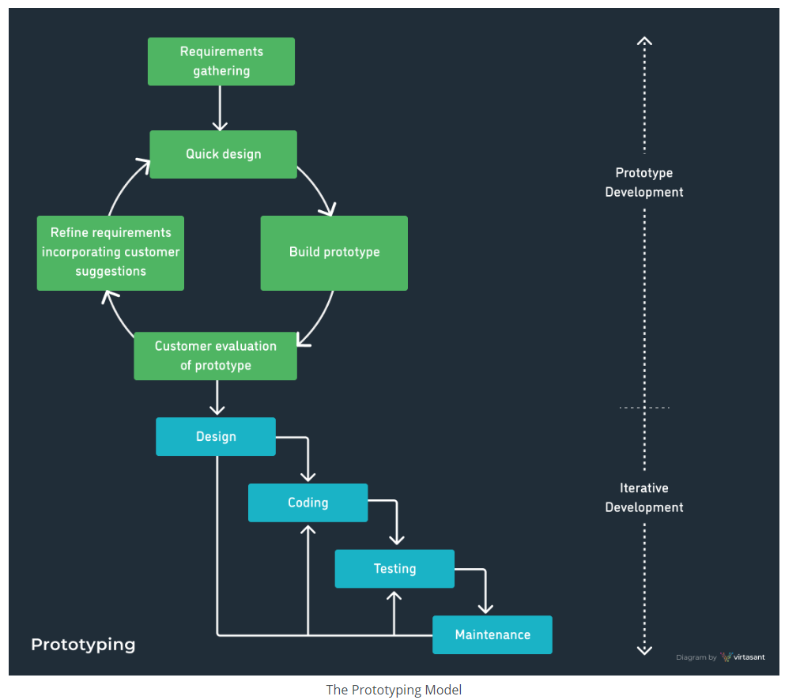
Prototype Model

Slide 27
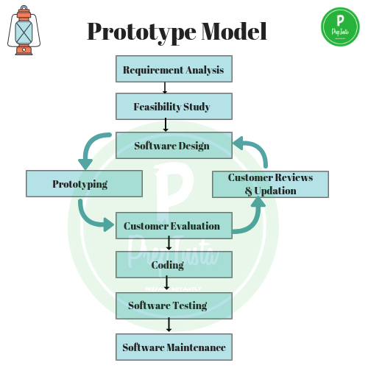
Prototype Model

Slide 28
Advantages & Disadvantages
Advantages:
Customer can see steady changes
This is useful when the requirements are changing rapidly
Disadvantages:
It is impossible to know how long it will take
There is no way to know the no of iterations will be required

Slide 29
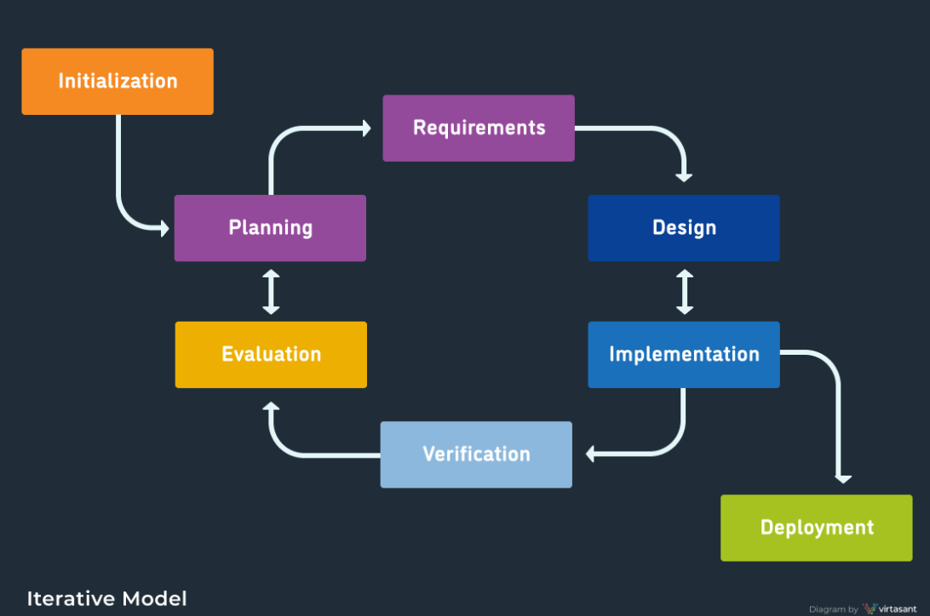
Iterative Model

Slide 30
Advantages & Disadvantages
Advantages | Disadvantages
The software will be generated quickly during the software life cycle | It requires a good planning designing
It is flexible and less expensive to change requirements and scope | Problems might cause due to system architecture as such not all requirements collected up front for the entire software lifecycle
Throughout the development stages changes can be done | Each iteration phase is rigid and does not overlap each other
This model is less costly compared to others | Rectifying a problem in one unit requires correction in all the units and consumes a lot of time
A customer can respond to each building
Errors are easy to be identified

Slide 31
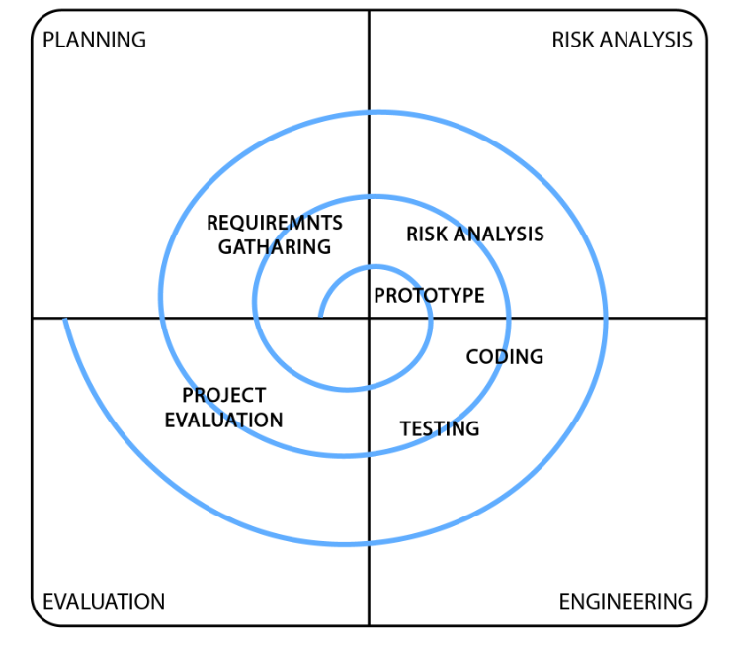
Spiral Model

Slide 32
Various Risks in Project
Cost Risk
Schedule Risk
Performance Risk
Operational Risk
Market Risk
Governance Risk
Legal Risk

Slide 33
Spiral Model Contd…
It is the combination of Water fall model & Iterative model
Each phase in spiral model begins with design goal & ends with client reviewing
Software is developed in a series of incremental releases.

Slide 34
When to use Spiral Model?
When risk & cost evaluation is important
For medium to high risk projects
When project is large and mission critical
When releases are required to be frequent
When requirements are unclear & complex
When changes may require at any time

Slide 35
Advantages & Disadvantages
Advantages
Disadvantages
Additional functionality or changes can be done at later stage
Cost estimation becomes easy as the prototype building is done in small fragments
Development is fast & features are added in a systematic way
There is always space for customer feedback.
Risk of not meeting the schedule or budget
Spiral development works best for large projects only also demands risk assessment expertise
Documentation is more as it has intermediate phase
It is not advisable for smaller projects, it might cost them a lot

Slide 36
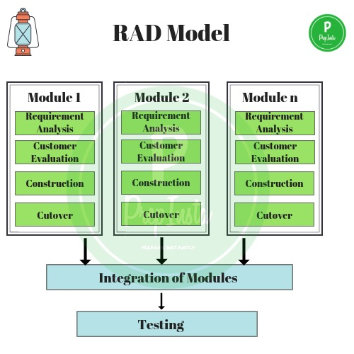
RAD Model

Slide 37
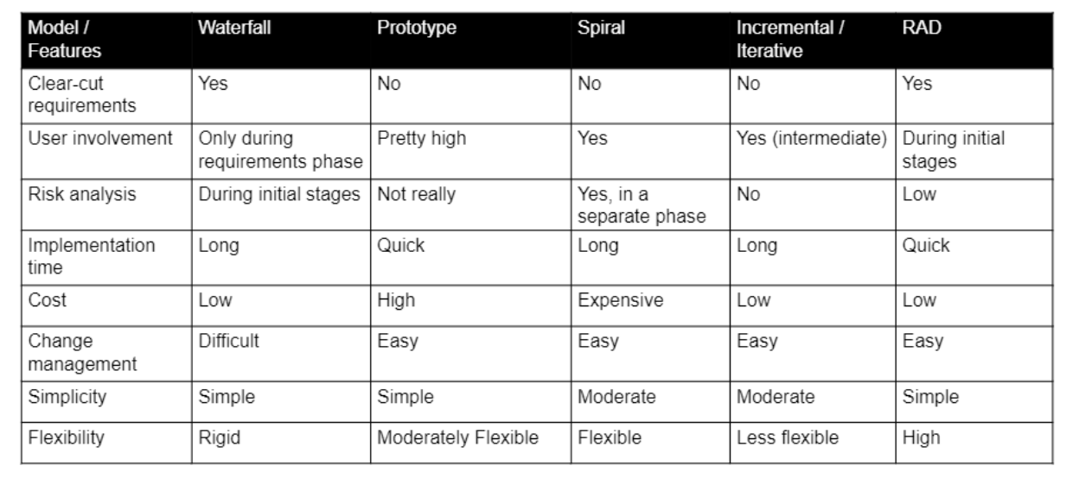
Comparison of various SDLC Model

Slide 38
Agile Methodology

Slide 39
What is Agile Methodology
Agile Methodology is a practice that promotes continuous iteration of Incremental development and testing throughout the software development lifecycle of the project.

Slide 40
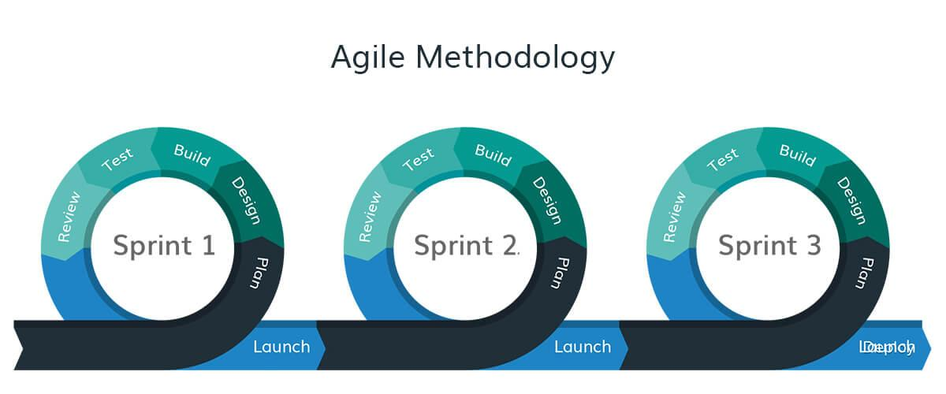
What is Agile Methodology

Slide 41
Why Agile?
Higher Customer Satisfaction
Flexibility and Adaptivity to accept changes
Better Quality
Better Productivity

Slide 42
When to use Agile
Agile is preferred over traditional models of software development, like waterfall, if the project has any of the following characteristics:
Lack of clearly defined requirements due to:
high degree of complexity of the required software system (E.g.: Unique Identification System for a country's citizens)
high degree of novelty i.e.- a completely new idea for a software without any precursors as reference (E.g.: Engine control system of a self-driving car)
Aggressive deadlines

Slide 43
Agile Manifesto: Principles
The 4 values of Agile are:
Individuals and Interactions Over Processes and Tools
Working Software Over Comprehensive Documentation
Customer Collaboration Over Contract Negotiation
Responding to Change Over Following a Plan

Slide 44
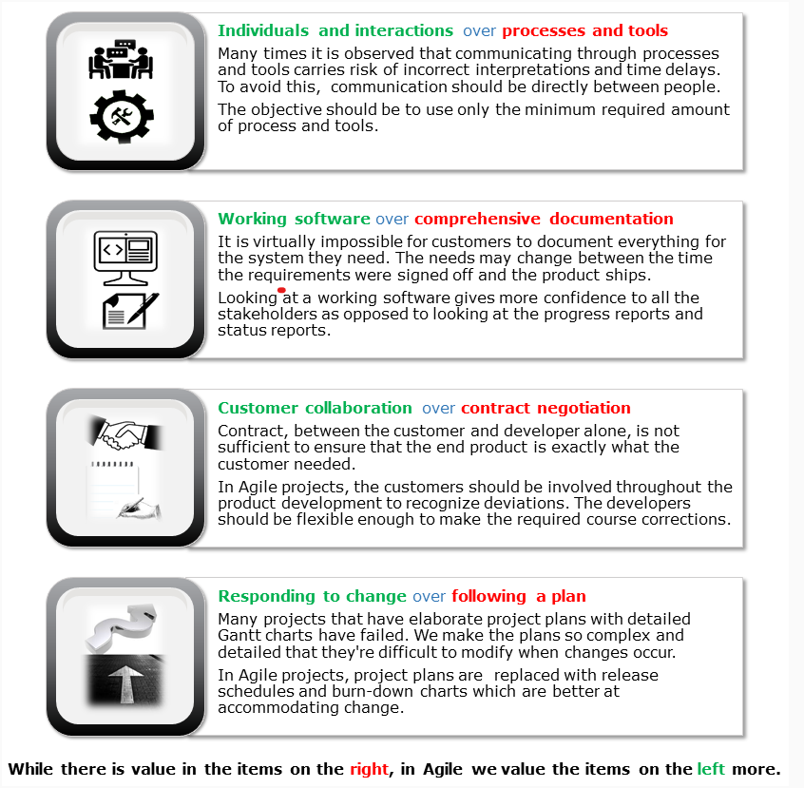
Agile Manifesto

Slide 45
Different Agile Methodologies
Scrum
Kanban
Extreme Programming (XP)
Lean
Crystal Methodologies
Dynamic Software Development Method
Features Driven Deployment

Slide 46
Scrum Overview
Roles
Issues
Backlogs
Events / Stage
Product Owner
Epic
Release Planning
Product Backlog
User Story
Sprint Planning
Sprint Backlog
Scrum Master
Bug
Daily Scrum
Dev Team (Dev + Tester)
Task
Sprint Review
Sprint Retrospective
DoR(DEFN OF READY)
Burn Up Chart
DoD (DEFN OF DONE)
Burn Down Chart

Slide 47
SCRUM
What is Scrum
SCRUM is an agile development method which concentrates specifically on how to manage tasks within a team-based development environment. Basically, Scrum is derived from activity that occurs during a rugby match. Scrum believes in empowering the development team and advocates working in small teams (say- 7 to 9 members).
It consists of three roles, and their responsibilities are explained
Product Owner
Scrum Master
Scrum Team

Slide 48
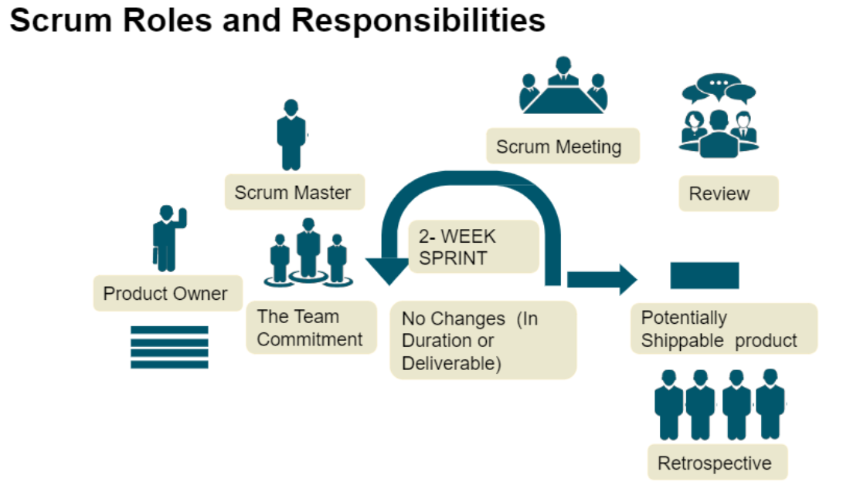
Agile / Scrum Team

Slide 49
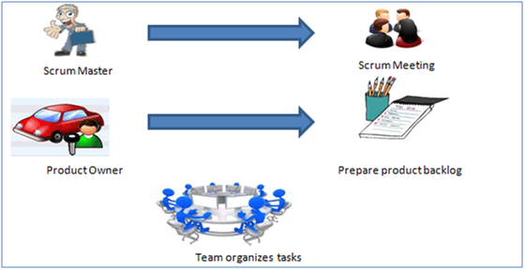
SCRUM

Slide 50
SCRUM
Scrum Master
Master is responsible for setting up the team, sprint meeting and removes obstacles to progress
Product owner
The Product Owner creates product backlog, prioritizes the backlog and is responsible for the delivery of the functionality at each iteration
Scrum Team
Team manages its own work and organizes the work to complete the sprint or cycle

Slide 51
Process Flow of SCRUM
Process flow of scrum testing is as follows:
Each iteration of a scrum is known as Sprint
Product backlog is a list where all details are entered to get the end-product
During each Sprint, top user stories of Product backlog are selected and turned into Sprint backlog
Team works on the defined sprint backlog
Team checks for the daily work
At the end of the sprint, team delivers product functionality

Slide 52
Responsibility of Product Owner
Drives the product from business perspective.
Responsibilities.
To create the Product Backlog
To define the user stories and prioritize their values
To determine the release date and contents
To take an active role in release planning and sprint planning meetings
To monitor and track that team is working on the most valued requirement
To represent the voice of the customer
To move the requirement to sprint (DoR – Definition of Ready) and accept the user stories which meets the definition of done (DoD) and defined acceptance criteria.

Slide 53
DoR and DoD
DoR (Definition of Read)
The user stories coming into sprint is called Definition of Ready
Definition of Done
The product coming out of the sprint is called Definition of Done

Slide 54
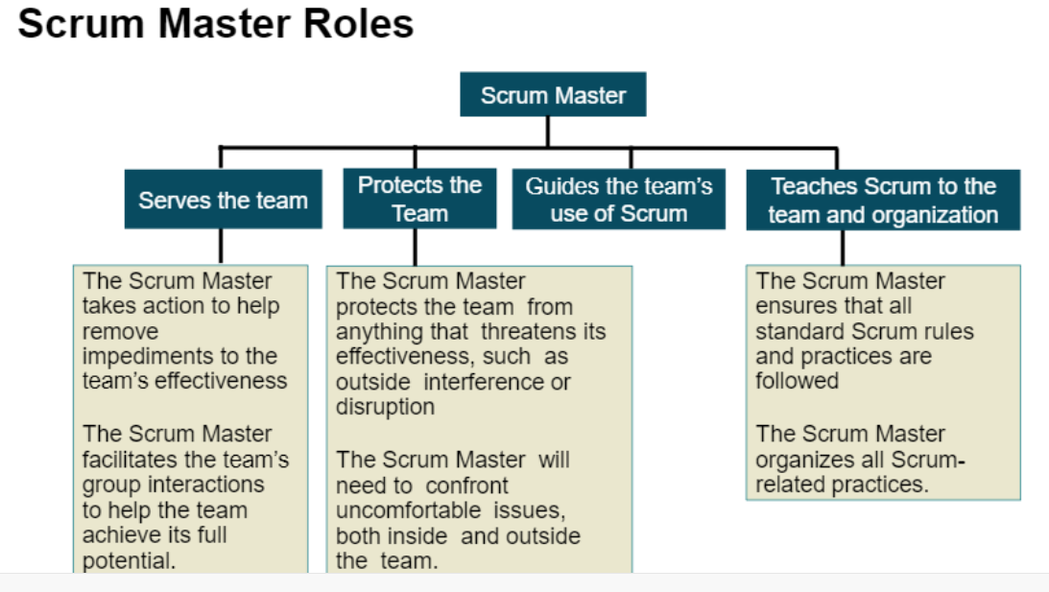
Responsibility of Scrum Master

Slide 55
Responsibility of Scrum Master
Facilitator of team who helps them to follow agile practices so that they can meet their commitments.
Responsibilities.
To enable close co-operation between all roles and functions.
To remove any blocks.
To shield team from any disturbance.
To work with the organization to track progress and processes of company.
To ensure that Agile inspect & Adapt process are leveraged properly which includes.
Scrum Meeting / Daily stand up calls
Review
Retrospective meetings
Other Planned meetings
To facilitate team meetings and decision making process.

Slide 56
Responsibility of Development Team
Provide effort estimates of the items in the product backlog.
Negotiate the sprint goal with the product owner.
Design, code, and test the increment daily.

Slide 57
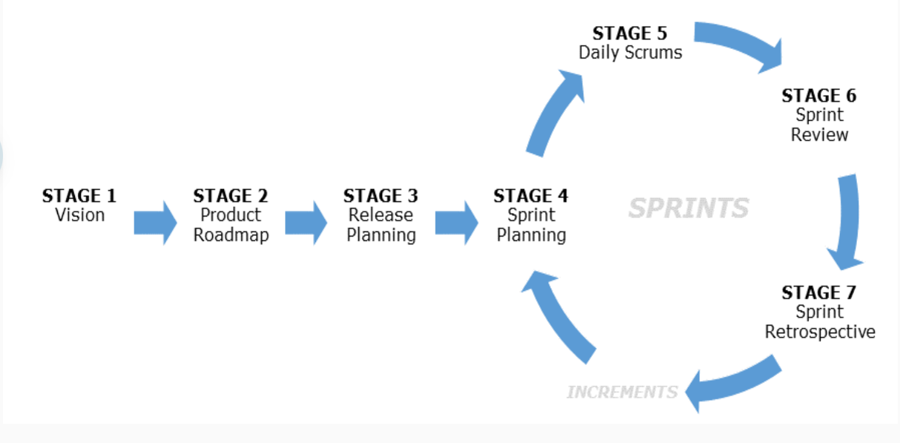
Scrum Stages / Events

Slide 58
Scrum Events
Sprint: Iterative time boxes where a goal is accomplished. Time frame does not exceed one calendar month and are consistent throughout the development process.
Sprint planning: Where the entire Scrum team get together — at the beginning of every Sprint — to plan the upcoming sprint.
Scrum Meeting / Daily Scrum : 15 minute time boxed meeting held at the same time, every day of the Sprint, where the previous day’s achievements are discussed, as well as the expectations for the following one.
Sprint review: An meeting held at the end of every Sprint where the Scrum team present their Increment to the stakeholders, and discuss feedback.
Sprint retrospective: A meeting where the Scrum team reflect on the proceedings of the previous Sprint and establish improvements for the next Sprint.

Slide 59
Scrum Artifacts
Product backlog: Managed by the Product Owner, it’s where all the requirements needed for a viable product are listed in order of priority. Includes features, functions, requirements, enhancements, and fixes that authorize any changes to be made to the product in future releases.
Sprint backlog: A list of the tasks and requirements that need to be accomplished during the next Sprint. Sometimes accompanied by a Scrum task board, which is used to visualize the progress of the tasks in the current Sprint, and any changes that are made in a ‘To Do, Doing, and Done’ format.
Burn-up charts represent how much work has been completed in the project
Burn-down chart represents the remaining work in a project.
User Stories: User Stories defines the actual business requirement. Generally created by Product owner.
Epic: A group of related user stories is called an Epic.
Task: To accomplish the business requirements Development Team and Testing Team create tasks.
Increment: The sum of all the product backlog items completed in every sprint.

Slide 60
Scrum Artifacts
Task board is dash board which shows progress of the project. It contains:
User Story: which has the actual business requirement.
To Do: Tasks that can be worked on.
In Progress: Tasks in progress.
Done: Completed tasks.
Daily stand up meeting is essential for any team in which-
Team discuss about how much work has been completed.
What are the plans to resolve technical issues.
What steps need to done to complete the projects etc.

Slide 61
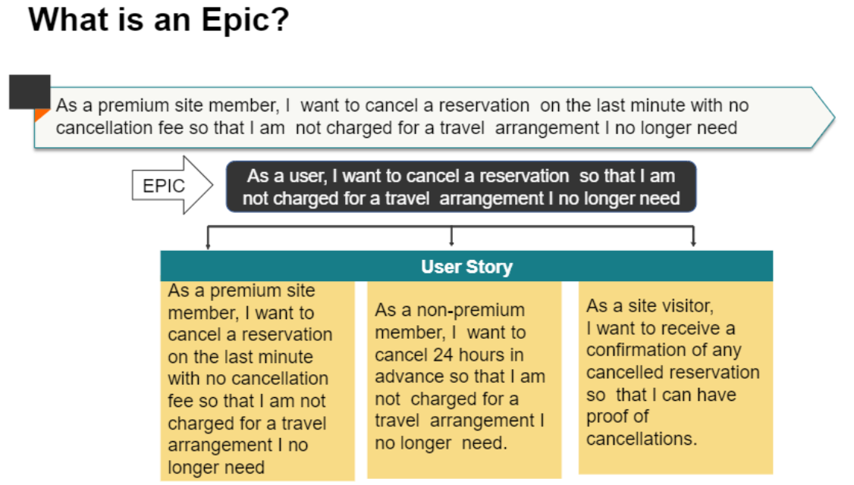
Scrum Artifacts

Slide 62
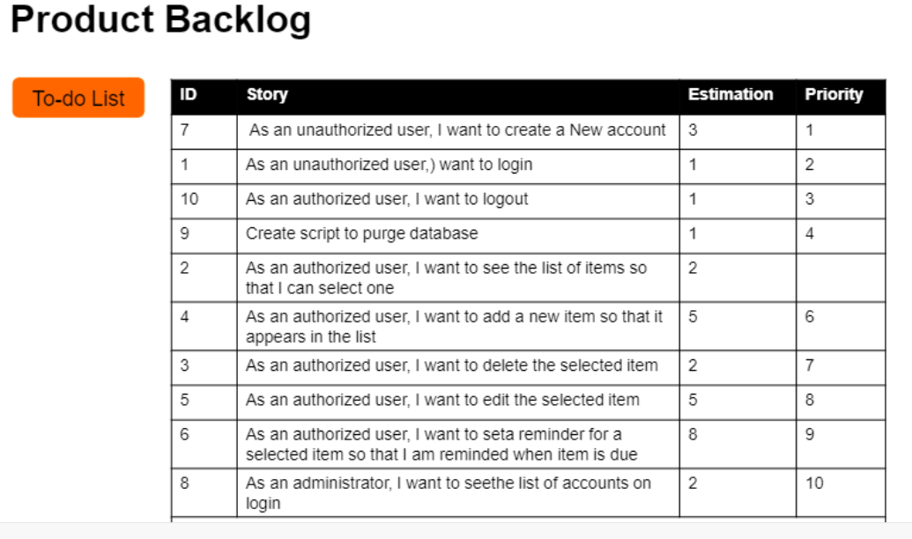
Scrum Artifacts

Slide 63
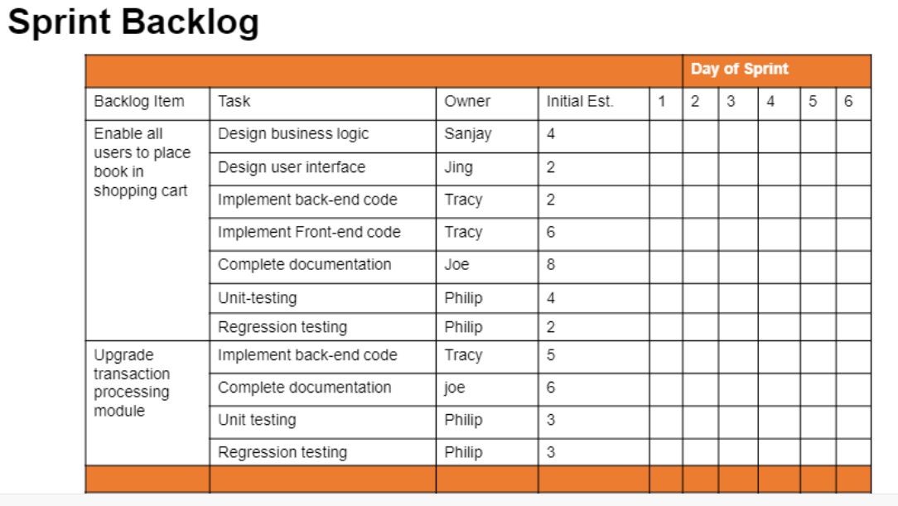
Scrum Artifacts

Slide 64
Waterfall vs Agile
Waterfall | Agile
Development of the software flows sequentially from start point to end point. | Agile method proposes incremental and iterative approach to software design
The customer can only see the product at the end of the project | The customer has early and frequent opportunities to look at the product and make decision and changes to the project
Testers work separately from developers | Testers and developers work together
The design process is not broken into an individual models | The agile process is broken into individual models that designers work on
Waterfall model are more secure because they are so plan oriented | Agile model is considered unstructured compared to the waterfall model
Only after the development, the whole product is tested. If the requirement error is found or any changes have to be made, the project has to start from the beginning | Error can be fixed in the middle of the project

Slide 65
Waterfall vs Agile
Waterfall | Agile
The development process is phased, and the phase is much bigger than iteration. Every phase ends with the detailed description of the next phase. | Development process is iterative, and the project is executed in short (2-4) weeks iterations. Planning is very less.
Only after the development phase, the testing phase is executed because separate parts are not fully functional. | Every iteration has its own testing phase. It allows implementing regression testing every time new functions or logic are released.
User acceptance is performed at the end of the project. | At the end of every sprint, user acceptance is performed
All features developed are delivered at once after the long implementation phase. | In agile testing when an iteration end, shippable features of the product is delivered to the customer. New features are usable right after shipment. It is useful when you have good contact with customers.
All sorts of project can be estimated and completed. | Small projects can be implemented very quickly. For large projects, it is difficult to estimate the development time.

Slide 66
The 12 Principles of Agile
There are 12 Agile principles:
Our highest priority is to satisfy the customer through early and continuous delivery of valuable software.
Welcome changing requirements, even late in development. Agile processes harness change for customer’s competitive advantage.
Deliver working software frequently, from a couple of weeks to a couple of months, with a preference to the shorter timescale.
Business people and developer must work together daily throughout the project.
Build projects around motivated individuals. Give them the environment and support they need, and trust them to get the job done.
The most efficient and effective method of conveying information to and within the development team is face-to-face conversation.

Slide 67
Agile Principles Contd…
Working software is primary measure of progress. A software is not finished when it is successfully tested and delivered. It is finished when it is tested and accepted by end user.
Agile processes promote sustainable development. The sponsors, developers and users should be able to maintain a constant pace indefinitely.
Continuous attention to technical excellence and good design enhances the agility.
Simplicity – the art of maximizing the amount of work not done – is essential.
The best architectures, requirements and designs emerge from self organizing teams.
At regular intervals, the team reflects the how to become more effective, then tunes and adjusts it’s behaviour accordingly.

Slide 68
Agile Testing Quadrants
The four Quadrants are:
Quadrant 1: Technology-facing tests that support the team
Quadrant 2: Business-facing tests that support the team
Quadrant 3: Business-facing tests that critique the product
Quadrant 4: Technology-facing tests that critique the product

Slide 69
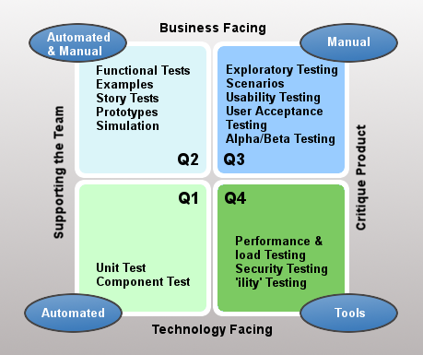
Agile Testing Quadrants

Slide 70
Lean Software Development
Lean Software Development is an iterative Agile methodology that focuses the team on delivering value to the customer through effective value stream mapping. It is a highly flexible, evolving methodology without rigid guidelines, rules, or methods.

Slide 71
Principles of Lean Methodology
Eliminating Waste
Amplifying Learning
Deciding as Late as Possible
Delivering as Fast as Possible
Empowering the Team
Building Integrity In
Seeing the Whole

Slide 72
Kanban
Kanban is a highly visual workflow management method that is popular among Lean teams. In fact, 83% of teams practicing Lean use Kanban to visualize and actively manage the creation of products with an emphasis on continual delivery, while not adding more stress to the software development life cycle. Like Scrum, Kanban is a process designed to help teams work together more effectively.

Slide 73
Principles of Kanban
Visualize what you’ll do today (workflow automation): Seeing all the items within the context of each other can be very informative
Limit the amount of work in progress (WIP): This helps balance the flow-based approach so teams don‘t start and commit to too much work at once
Enhance flow: When something is finished, the next highest priority item from the backlog is pulled into play

Slide 74
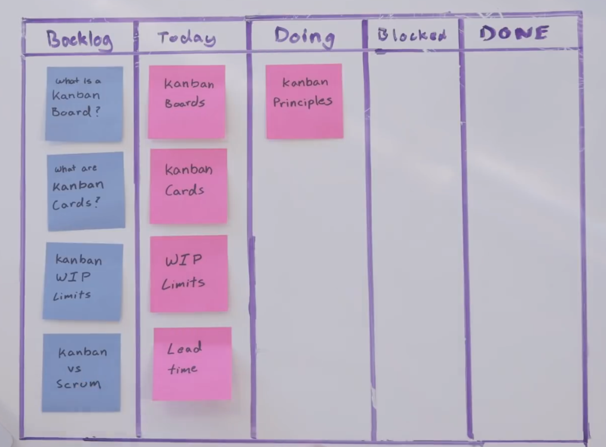
Principles of Kanban

Slide 75
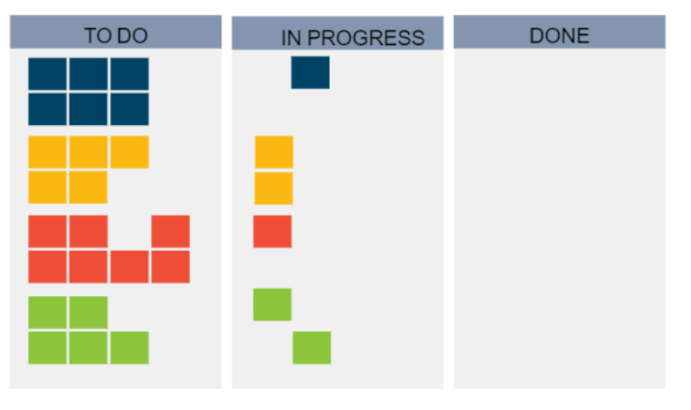
Principles of Kanban

Slide 76
Difference Between Kanban and Scrum
 | Kanban | Scrum
Roles and Responsibilities | There are no pre-defined roles for a team. Although there may still be a Project Manager, the team is encouraged to collaborate and chip in when any one person becomes overwhelmed. | Each team member has a predefined role, where the Scrum master dictates timelines, Product owner defines goals and objectives and team members execute the work.
Due Dates / Delivery Timelines | Products and processes are delivered continuously on an as-needed basis (with due dates determined by the business as needed). | Deliverables are determined by sprints, or set periods of time in which a set of work must be completed and ready for review.
Delegation & Prioritization | Uses a “pull system,” or a systematic workflow that allows team members to only “pull” new tasks once the previous task is complete. | Also uses a “pull system” however an entire batch is pulled for each iteration.
Modifications / Changes | Allows for changes to be made to a project mid-stream, allowing for iterations and continuous improvement prior to the completion of a project. | Changes during the sprint are strongly discouraged.
Measurement of Productivity | Measures production using “cycle time,” or the amount of time it takes to complete one full piece of a project from beginning to end. | Measures production using velocity through sprints. Each sprint is laid out back-to-back and/or concurrently so that each additional sprint relies on the success of the one before it.
Best Applications | Best for projects with widely-varying priorities. | Best for teams with stable priorities that may not change as much over time.

Slide 77
Extreme Programming (XP)
Extreme Programming (XP), is light weight methodology for small to medium sized teams developing the software in the face of vague or rapidly changing requirements which was described by Kent Beck. It promotes high customer involvement, rapid feedback loops, continuous testing, continuous planning, and close teamwork to deliver working software at very frequent intervals, typically every 1-3 weeks.
The methodology takes its name from the idea that the beneficial elements of traditional software engineering practices are taken to “extreme” levels. As an example, code reviews are considered a beneficial practice. Taken to the extreme, code can be reviewed continuously through the practice of pair programming.
The original XP method is based on four simple values:
Simplicity
Communication
Feedback
Courage.

Slide 78
When to use XP?
Expect their system’s functionality to change every few months.
Experience constantly changing requirements or work with customers who aren’t sure what they want the system to do.
Want to mitigate project risk, especially around tight deadlines.
Include a small number of programmers (between 2 and 12 is preferable).
Are able to work closely with customers.
Are able to create automated unit and functional tests.

Slide 79
Advantages and Disadvantages
Advantages | Disadvantages
Close contact with the customer | Additional work
No unnecessary programming work | Customer must participate in the process
Stable software through continuous testing | Relatively large time investment
Error avoidance through pair programming | Relatively high costs
No overtime, teams work at their own pace | Requires version management
Changes can be made at short notice | Requires self-discipline to practice
Code is clear and comprehensible at all times

Slide 80
Crystal
The Crystal methodology is one of the most lightweight, adaptable approaches to software development.
Crystal is actually comprised of a family of Agile process models, including Crystal Clear, Crystal Yellow, Crystal Orange and others. Each has unique characteristics driven by several factors, such as team size, system criticality, and project priorities. This Crystal family addresses the realization that each project may require a slightly tailored set of policies, practices, and processes in order to meet the product ‘s unique characteristics.
Introduced by Alistair Cockburn, Crystal focuses primarily on people and the interaction among them while they work on an agile software development project. There is also a focus on business-criticality and business-priority of the system under development.
Unlike traditional development methods, Crystal doesn’t try to fix the tools and techniques of development but keeps people and processes at the core of the process. However, it is not only the people or the processes that are important, rather the interaction between them that is most important.
Several key tenets of Crystal include teamwork, communication, and simplicity, as well as reflection to frequently adjust and improve the process. Like other Agile frameworks, Crystal promotes early, frequent delivery of working software, high user involvement, adaptability, and the removal of bureaucracy or distractions.

Slide 81
Dynamic Systems Development Method (DSDM)
The Dynamic Systems Development Method (DSDM) is an Agile approach that grew out of the need to provide a common industry framework for rapid software delivery. Since 1994, the DSDM methodology has evolved to provide a comprehensive foundation for planning, managing, executing, and scaling Agile process and iterative software development projects.
DSDM is based on eight key principles that direct the team and create a mindset to deliver on time and within budget. These agile principles primarily revolve around business needs/value, active user involvement, empowered teams, frequent delivery, integrated testing, and stakeholder collaboration. DSDM specifically calls out “fitness for business purpose” as the primary criteria for delivery and acceptance of a system, focusing on the useful 80% of the system that can be deployed in 20% of the time.
Compromising any of the following principles undermines the philosophy of DSDM and introduces risk to the successful outcome of the project.

Slide 82
Principles of DSDM
Focus on the business need
Deliver on time
Collaborate
Never compromise quality
Build incrementally from firm foundations
Develop iteratively
Communicate continuously and clearly
Demonstrate control

Slide 83
Feature Driven Development (FDD)
Feature Driven Development is a model-driven, short-iteration process that was built around software engineering best practices such as domain object modelling, developing by feature, and code ownership. The blending of these practices that resulted in a cohesive whole is the best characteristic of FDD.
Feature Driven Development consists of five basic activities:
Development of an overall model
Building a feature list
Planning by feature
Designing by feature
Building by feature

